Slide 1
Innovation & Idea Submission Bot
Tauseef Ahmed
Prakyath H N

Slide 2
Overview
The chatbot application is designed to streamline the idea management process within the organization by enabling employees to easily submit, track, and evaluate ideas through a conversational interface. Built using Kore.ai and powered by a backend FastAPI service with MongoDB integration, the solution facilitates end-to-end management of employee-submitted ideas—from submission to review and feedback.

Slide 3
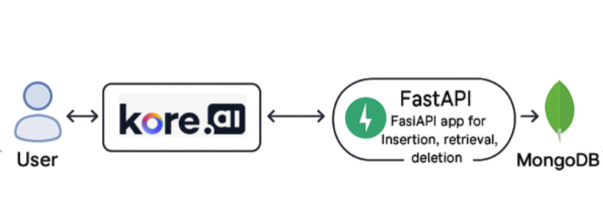
Architecture Diagram

Slide 4
Architecture Components
1.Kore.ai Chatbot:
Handles conversational workflows for both Employees and Admins.
Employee Flow: Enables authentication, idea submission, and viewing of previously submitted ideas.
Admin Flow: Provides functionalities to view, approve, or reject submitted ideas, offering end-to-end idea management through a natural language interface.

Slide 5
2. FastAPI App:
Backend service powering chatbot interactions
Exposes RESTful APIs for idea submission, retrieval, deletion, and admin actions
Integrates with MongoDB for data storage
Includes email service for notifications (e.g., idea status)
Enforces strict schema validation. Only predefined fields are accepted, ensuring data integrity and security
Ensures secure communication between Kore.ai chatbot and database

Slide 6
3. MongoDB:
Serves as the primary data store for all chatbot interactions.
Persists data such as user profiles, submitted ideas, approval statuses, and timestamps.
Supports fast querying and document-based storage, ideal for flexible and evolving data structures.

Slide 7
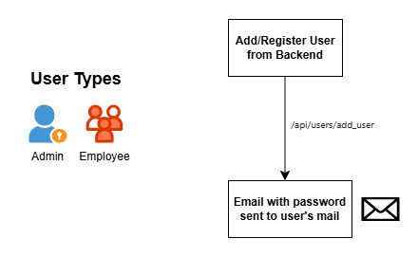
Flow/Demo

Slide 8
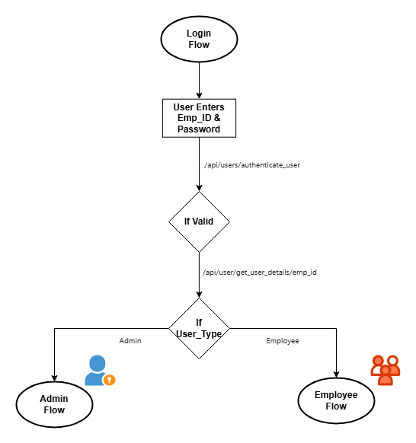
Flow/Demo

Slide 9
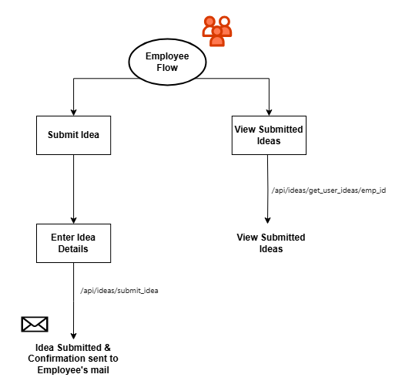
Flow/Demo

Slide 10
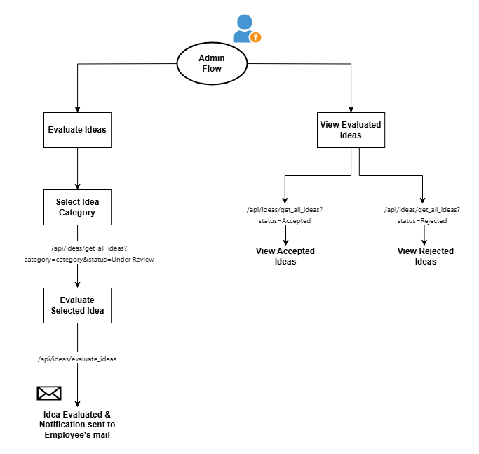
Flow/Demo

